Slide 1
Mission to Mars

Slide 2
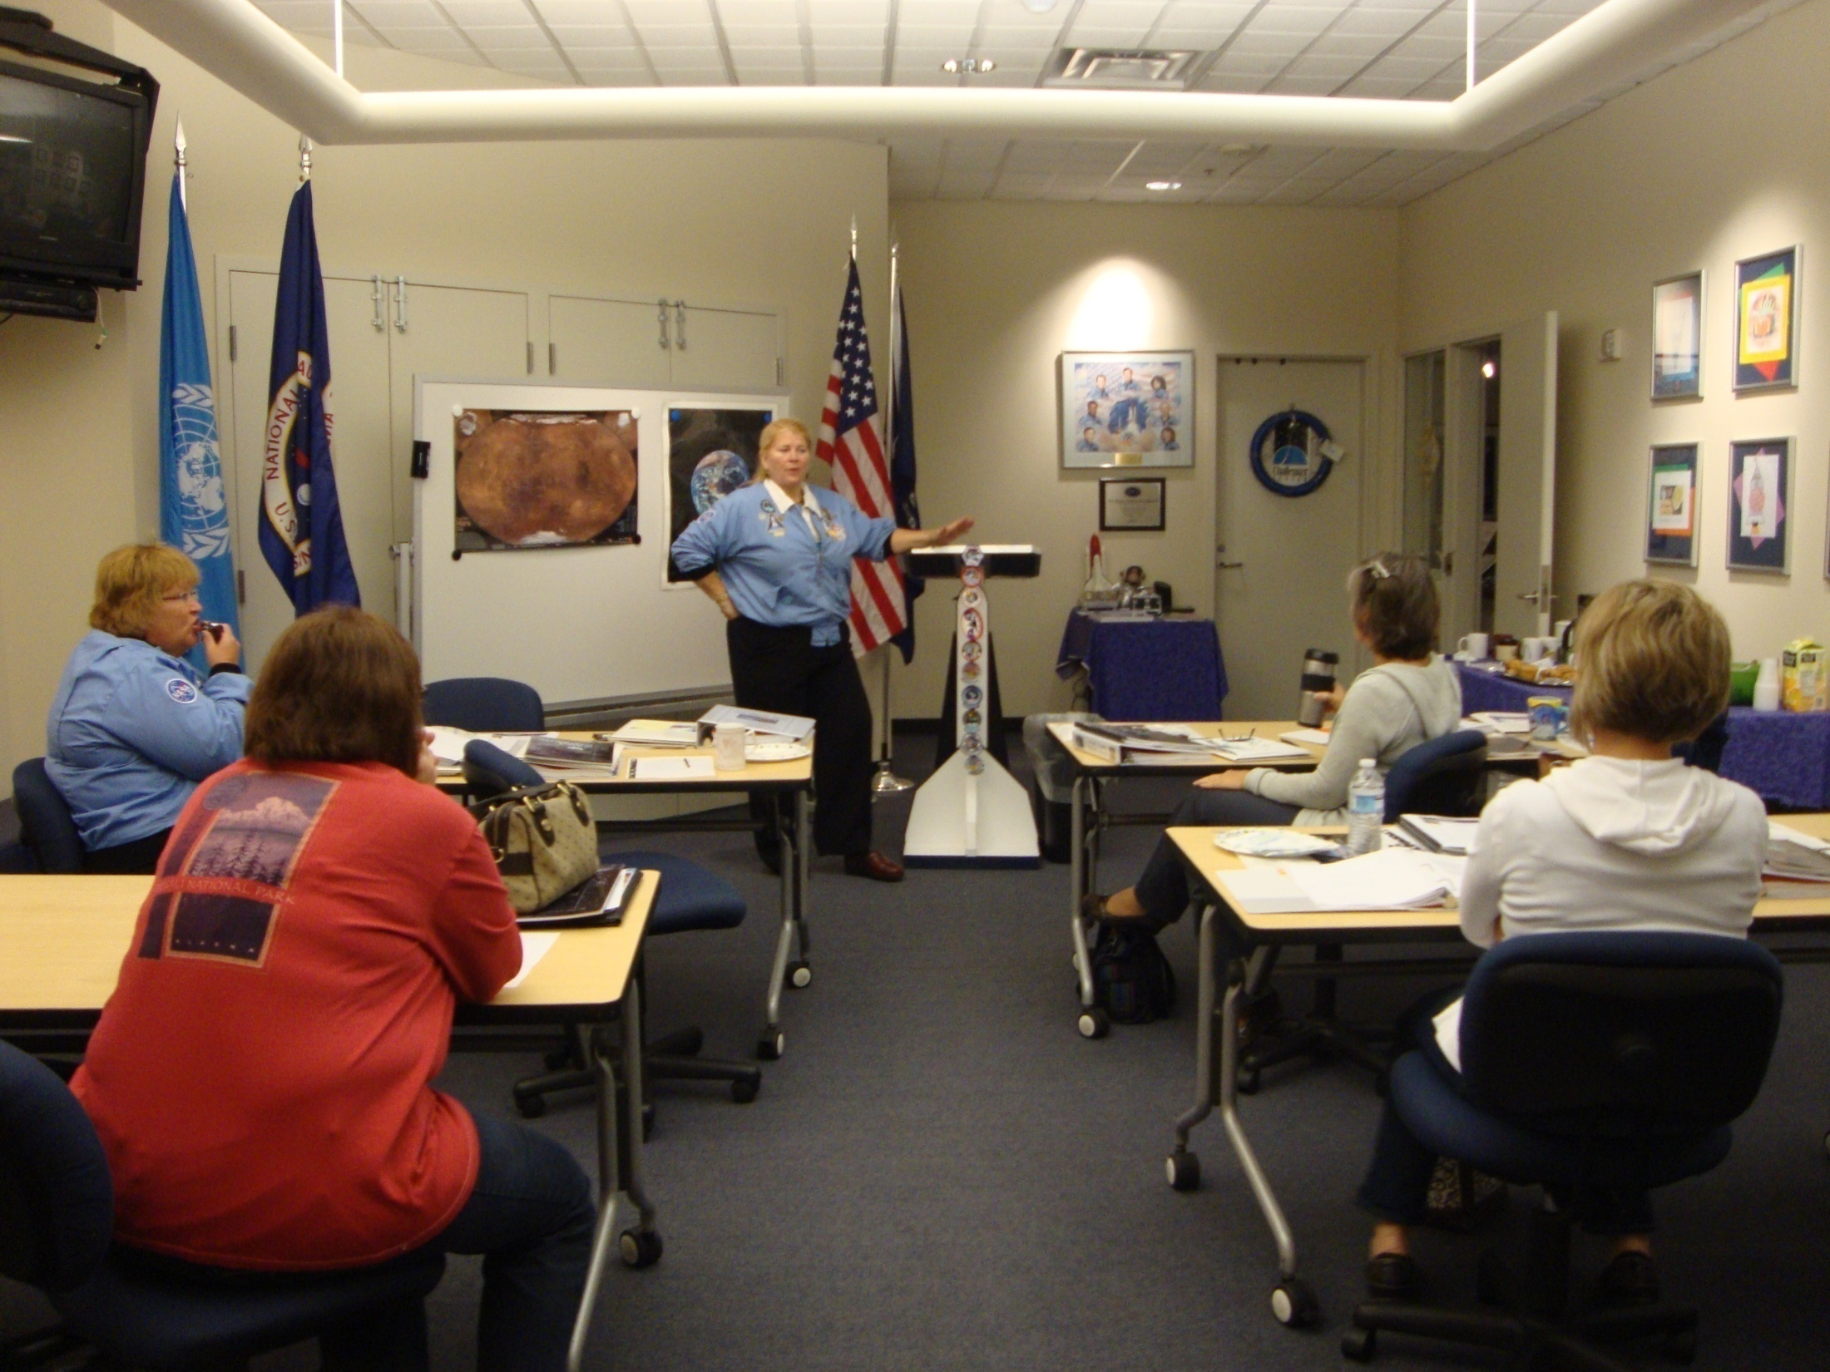

Slide 3
Those astronauts who are flying first head over to suit up!

Slide 4
You head through the airlock to get into the shuttle.

Slide 5
You will find the station that is for your job.

Slide 8
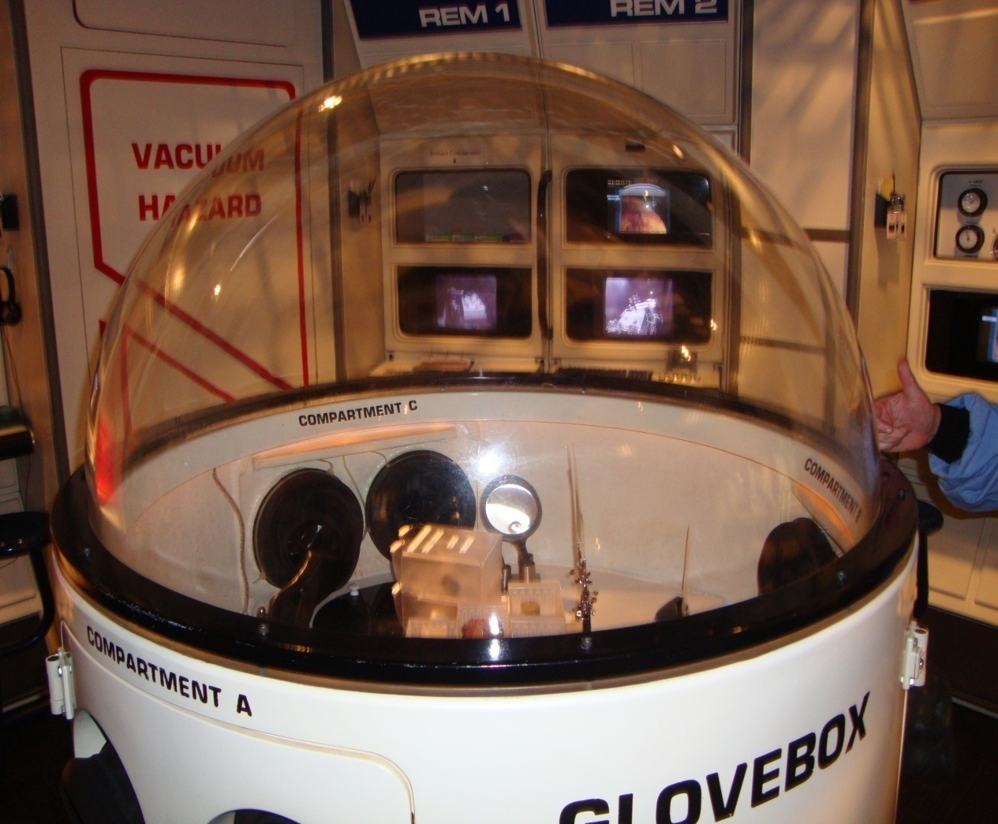
This is where the REM team does their experiments.

Slide 10
When the shuttle arrives to the station, you will go back to the main room and then go home on the shuttle. Those who were on the shuttle to replace you will take your place at Mission Control.

Slide 11
You will wear a badge that lets people know your job.

Slide 12
Your badge, paper and pencils are on the wall by your station. Your mission information is in a book at your station.

Slide 13
Video of the people you are working with at mission Control will be on the monitors. You will also get other information from the monitors at the front of the room.

Slide 14
If you start at Mission Control, you will go into a different room.

Slide 15
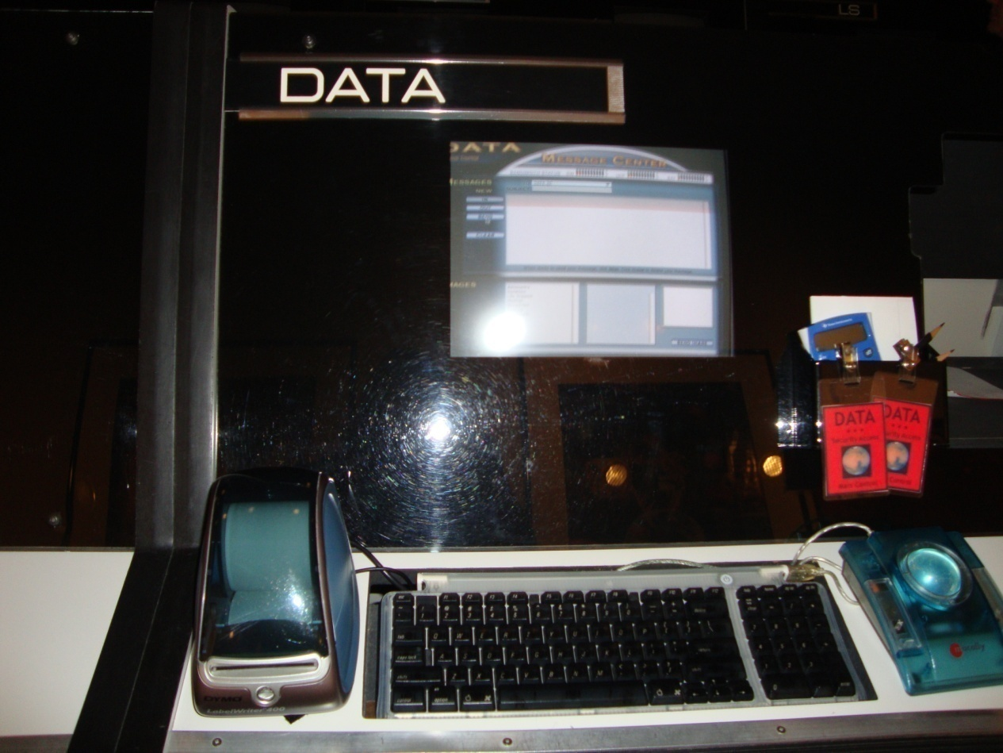
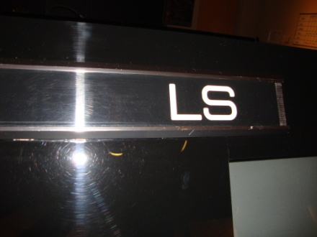
You will find your station and go there.

Slide 16
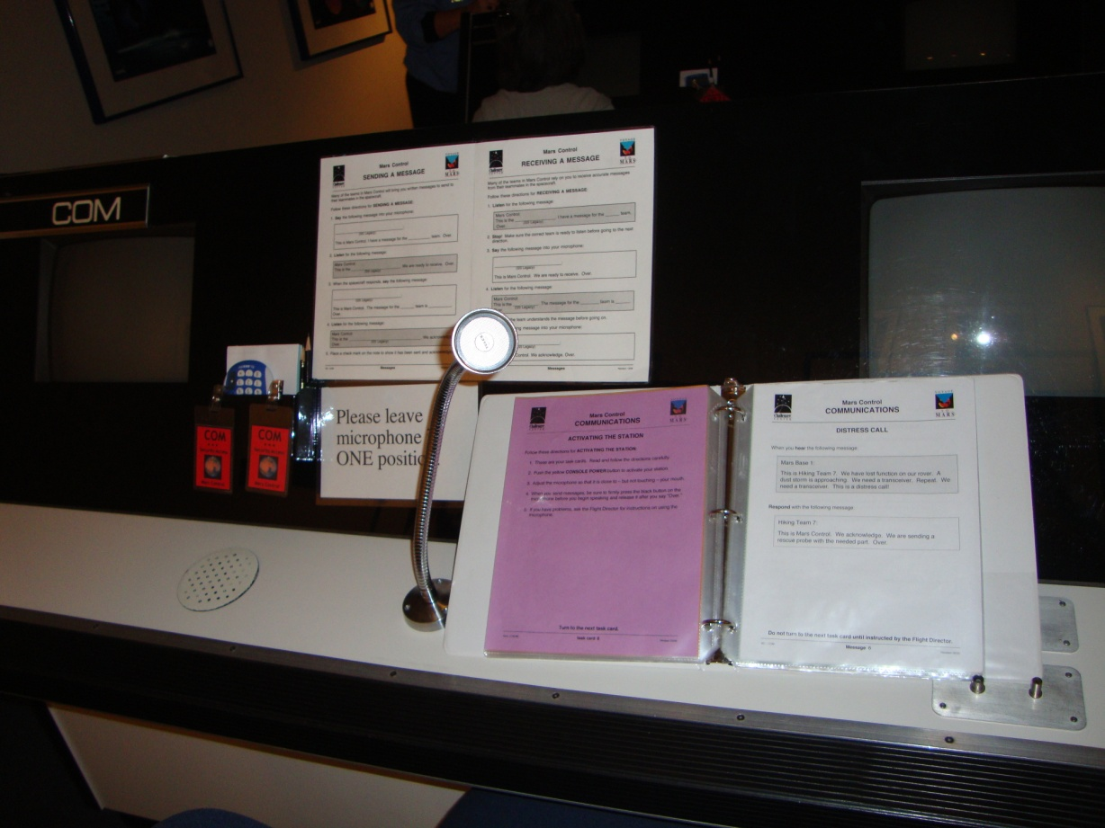
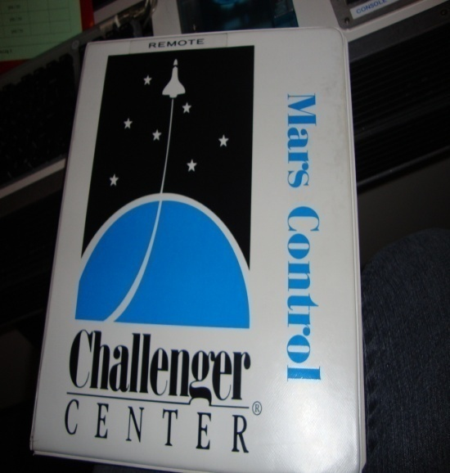
Your binder of directions, clipboard to help you with research, badge, pencil and paper are all at your station.

Slide 17
There will be monitors here also with information and video of the students who are on the mission.

Slide 18
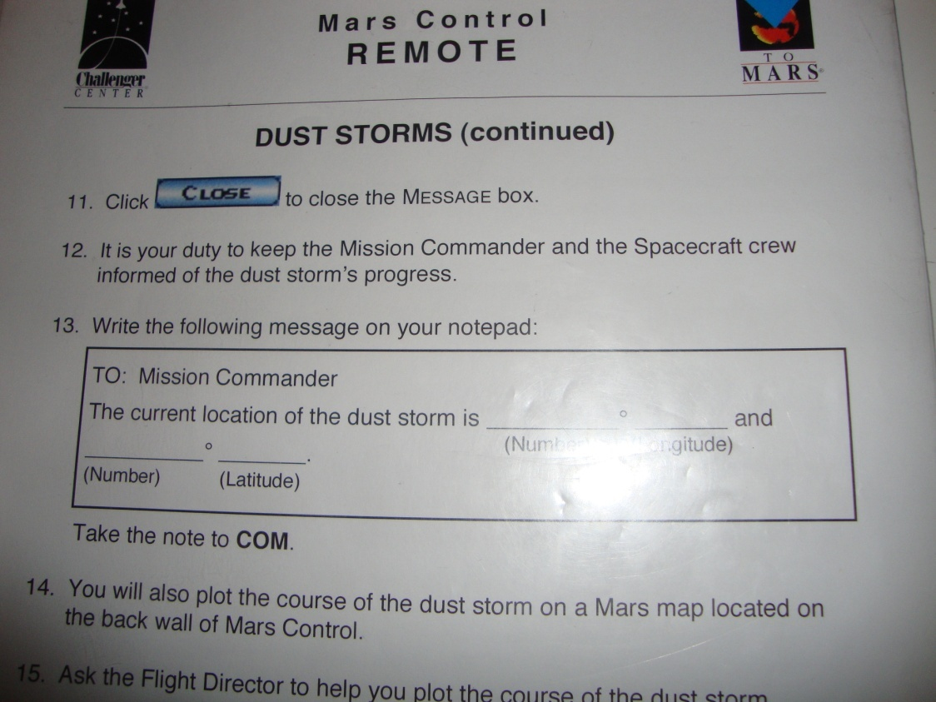
Mission Control
Your job will be to gather important information from research and from the students who are on the shuttle.

